Slide 1

Pacman assignment
Lecturer: Dr. Loo Chu Kiong
Student Name:Dong Yirui Matrix Num:17102165/1

Slide 2
Monte Carlo Tree Search
Selection
Expansion
Simulation
Backpropagation

Slide 3
TScontroller
getMove
Movetoward
MCTSjuece
TreePolicy —Selection
Fenzong --Simulation
Backpropagation --Backpropagation
Bestchild
Node

Slide 4
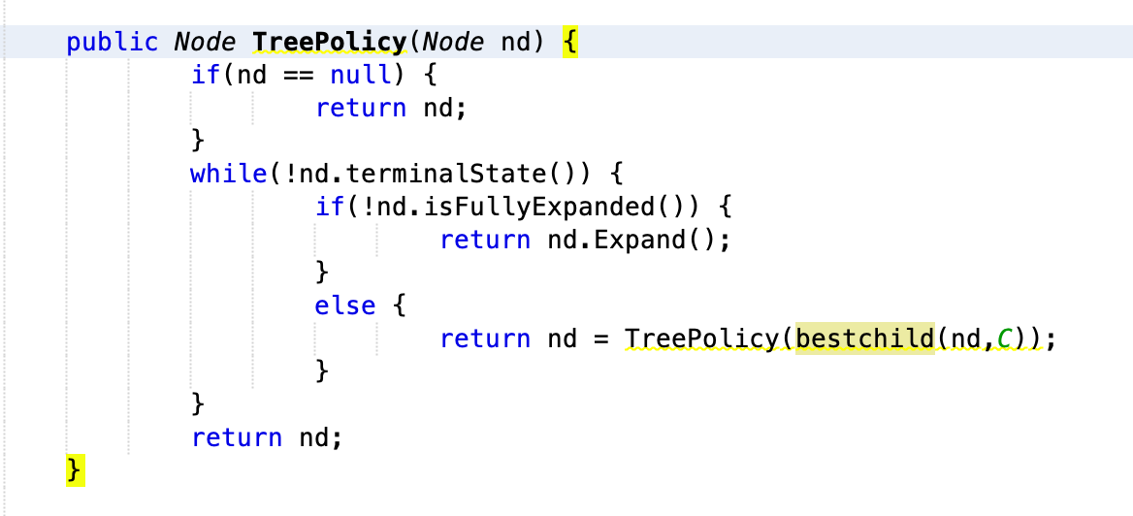
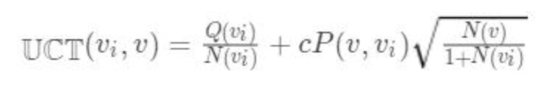
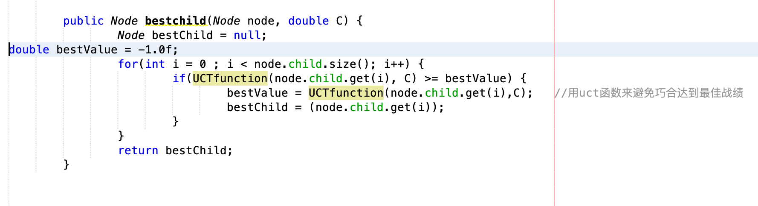
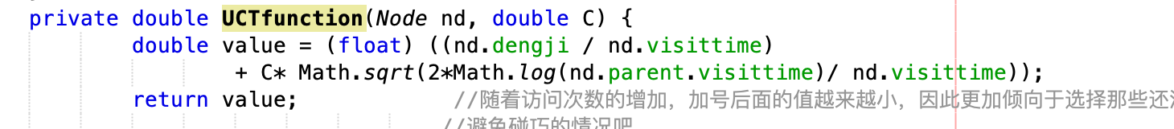
Selection

Slide 5
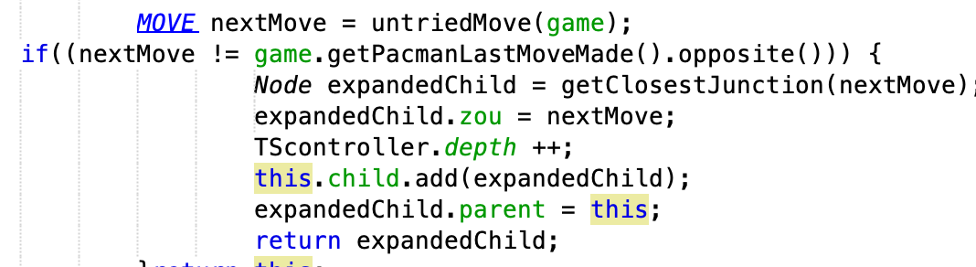
Expansion
Add the node with a statistic of "0/0" to a selected node and proceed to the next step of the simulation

Slide 6
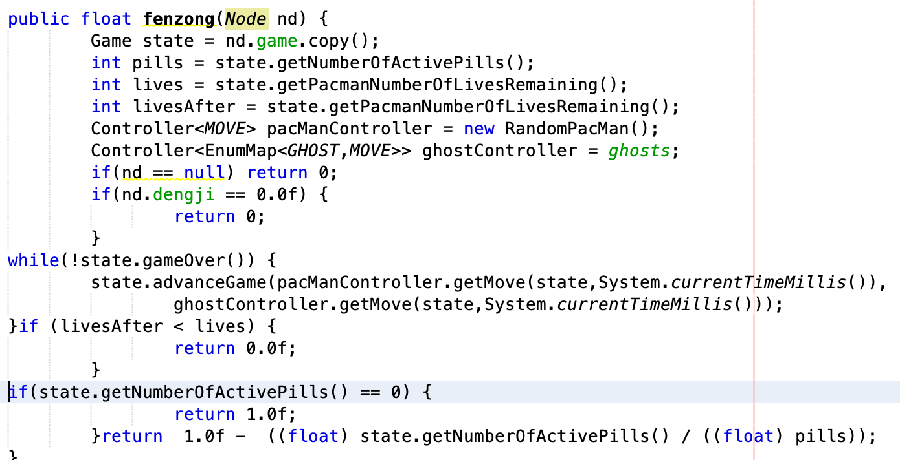
Simulation

Slide 7
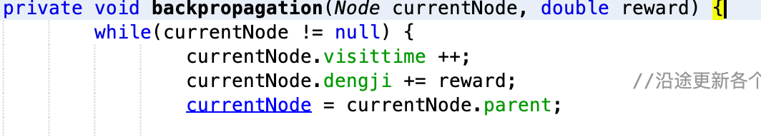
Backpropagation
Start at the child node and work backwards along the path just down, updating the statistics for each parent node along the way.

Slide 8
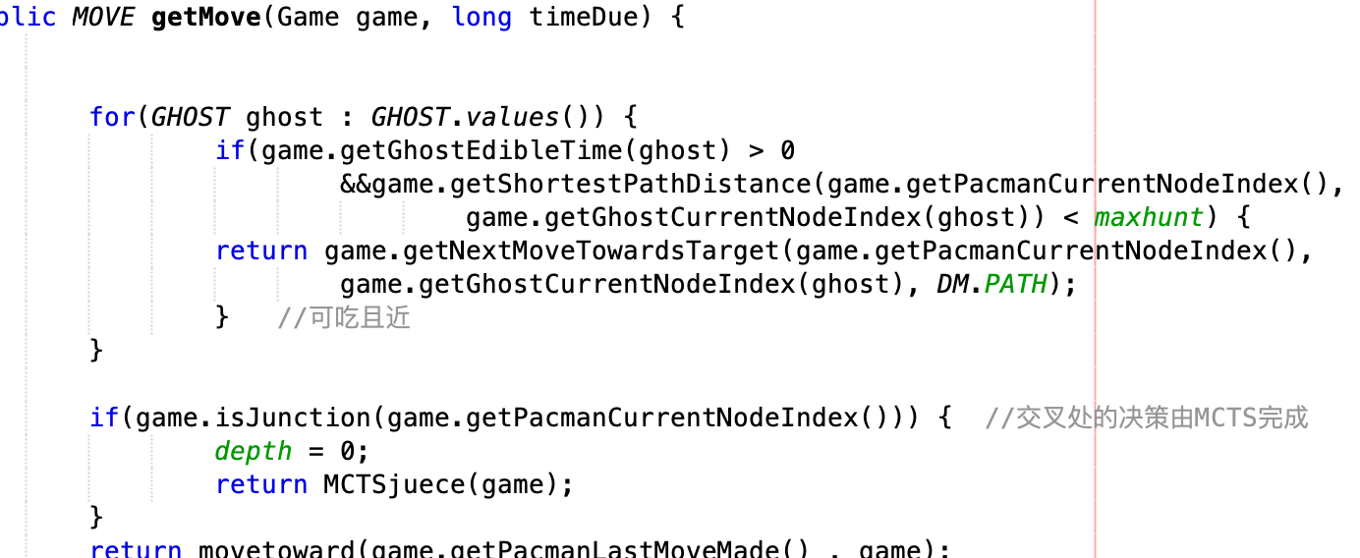
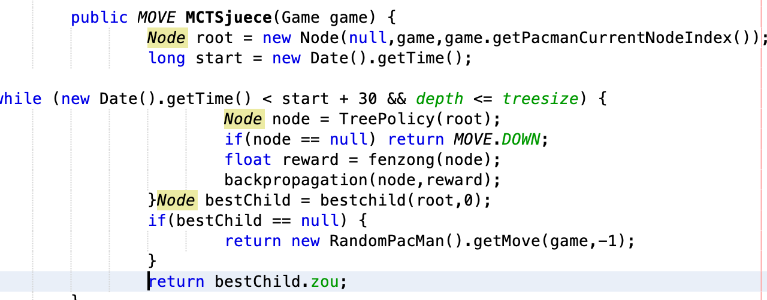

Slide 9
